Slide 1
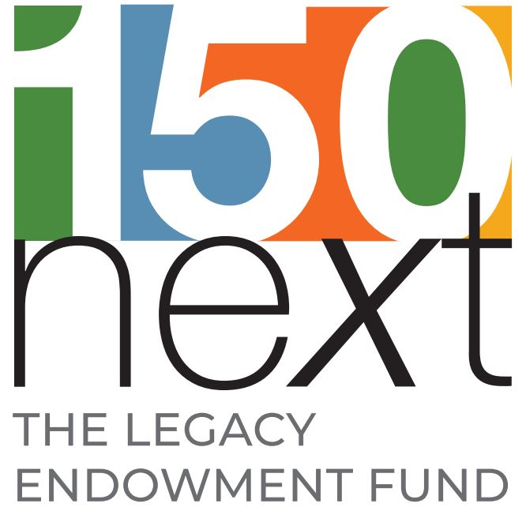
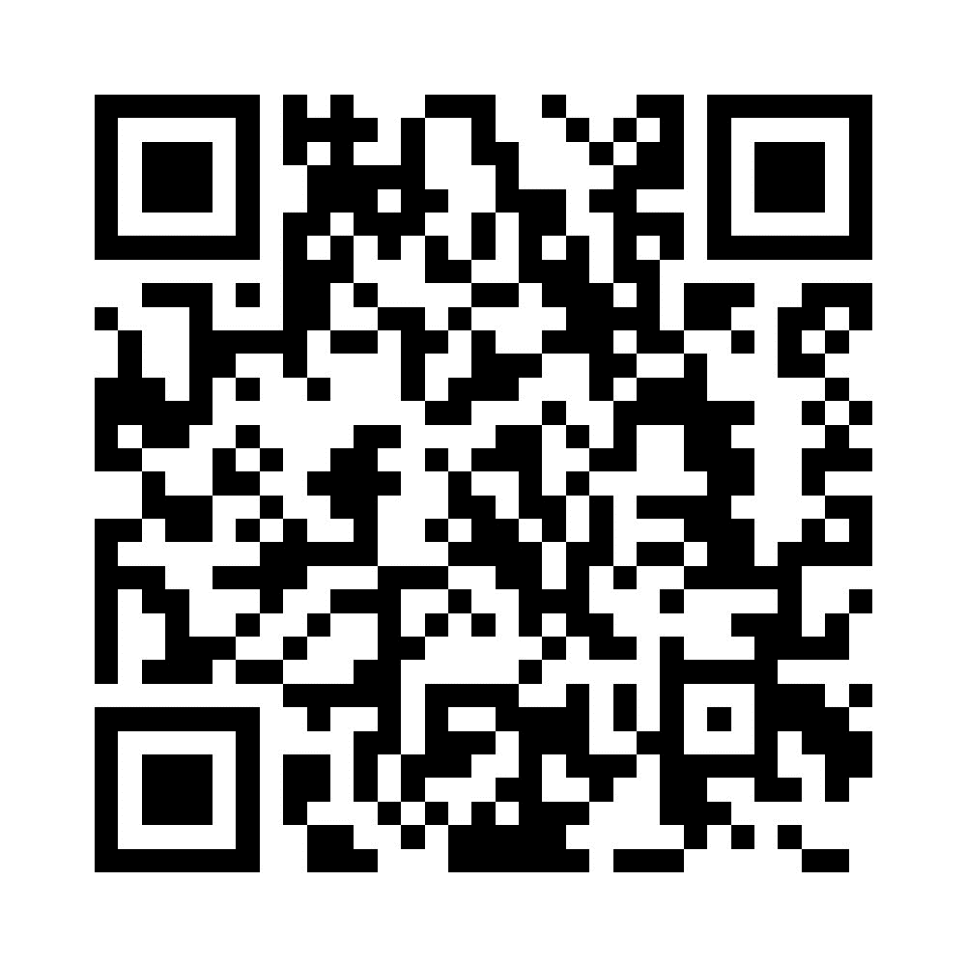
Ways to Give Today: Scan this QR Code to be directed to the giving page Text “LEGACY” to 20503 Thank you! Together we are building our Legacy!
Notes:
Dawn –
In the March/April edition of Response Magazine is an article headed with the words “Mission Giving Makes Mission Happen.” United Methodist Women’s missions include grants that help fund schools, hospitals, agricultural projects, and microenterprise projects just to name a few. In 2020 and 2021 UMW provided
more than $9 million to 226 national and international projects and partners, per this article. Mission Giving supports our organization TODAY.
The Legacy Endowment Fund will support our organization IN THE FUTURE. So, both are vital to the present and future of United Methodist Women/United Women in Faith. We need to continue to emphasize to our local women that their pledges are vitally needed especially in this time of the pandemic and general unrest in the world. It should be their first priority. But, for those of us who are have been given extra, we need to consider going over and above the pledge we make to our local organizations. “To those to whom much has been given…much will be required.” Luke 12:48

